Slide 1

Singapore Sports School
Corporate Pass Application
G2T8: Umar, Wei Khiang, Shuoan, Pei Ming, Li Qing, Aloysius

Slide 2

Agenda
01
Introduction
02
System Architecture
03
04
Libraries Used
Demo
05
Other flows
Notes:
When admin disable/delete an employee from the system, if the employee have future bookings, all his future bookings should also be cancelled

Slide 3
01
Introduction

Slide 4
Objectives
Digitisation
Process Improvement
Efficiency!
Digitising manual corporate pass booking process
Streamlining of corporate pass borrowing processes, thanks to the digitisation
More time for other tasks

Slide 5
02
System Architecture

Slide 6




Client-Server Architecture
Browser
Controller Layer
Controller Layer
Service Layer
Controller Layer
Repository Layer
Database
View
(React)
Notes:
Why Spring boot MVC?:
Promoting separation of concerns - it's great way to develop modular web applications
Abstracts away the tedious and boilerplate tasks of handling HTTP requests
Excellent support for developing RESTful web services

Slide 7
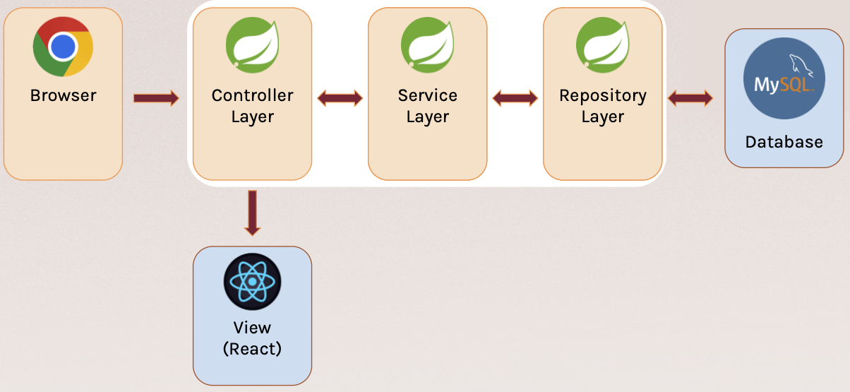
Layering
Spring Boot backend with React Frontend
Backend
Controller: Exposes API endpoints for the client
Service: Handles the logic required with the data retrieved from the database
Repository: Models the database and performs database related activities
Frontend
View: Renders the user interface
Notes:
Service -> open close

Slide 8

Client-Server Communication
REST APIs
Spring JDBC
API endpoints to allow communication with client
ORM for server to communicate with MySQL database

Slide 9
Design Principles (SOLID)
Single Responsibility Principle
Controller, Service, Repository and the frontend handles different responsibilities
Interface Segregation Principle
Service interface exposed to the client only contains client related methods
Dependency Inversion Principle
High level modules depending on abstractions over concrete implementations
Notes:
SRP -> controller service repo and front end handles different responsibilities
And in the code we aligned with Dont repeat yourself DRY
ISP -> Service interfaces exposed to the clients only contains client related methods
E.g. PDF generation’s logic are not exposed
DIP -> Autowiring service classes into the controller class

Slide 10
03
Libraries Used

Slide 11




Front End
Material UI
Every component you need is ready for production -> shorter development time -> faster shipping of features
Widely recognised and used in the industry

Slide 12



Back End
Spring Libraries
Email templates: Free-marker
PDF templates: Thymeleaf & flying-saucer
Emailing: Spring mail
Security: Spring security & JWT & OTP
Notes:
Free-marker -> Email templates
Thymeleaf + flying-saucer -> PDF templates
Spring mail -> Mail
JWT + spring security + OTP-> security

Slide 13
04
Demo
Notes:
Employee
Register → Login → Book (show exceed limit, show cannot book date out of range)→ check bookings → cancel bookings
Admin
Show stats → show employee CRUD → add attractions → add corporate pass
GOP
Issue and Collect pass

Slide 14
05
Other flows

Slide 15
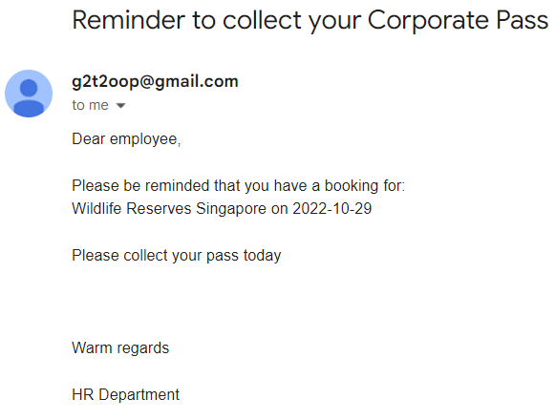
Reminder to collect
Emails will be sent out everyday at 12pm to those that have a booking the next day

Slide 16
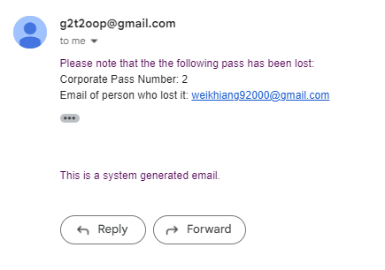
Lost mail
If passes are lost, email will be sent to HR stating who lost it

Slide 17
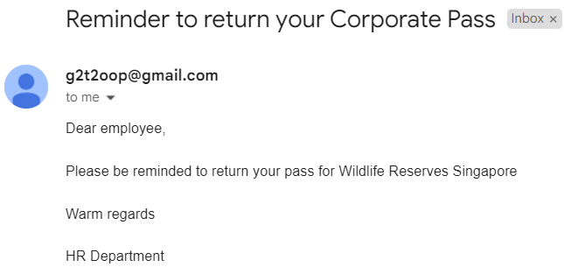
Reminder to return
Emails will be sent out everyday at 12pm to people in possession of the loaned passes

Slide 18
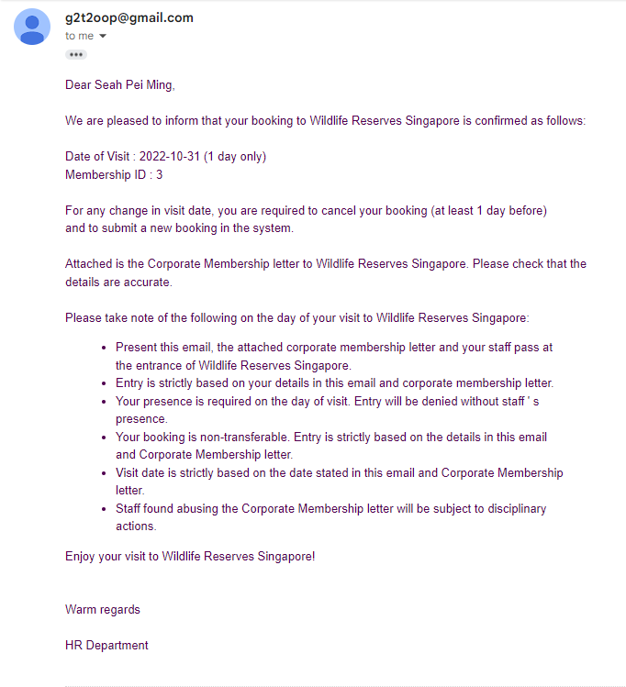
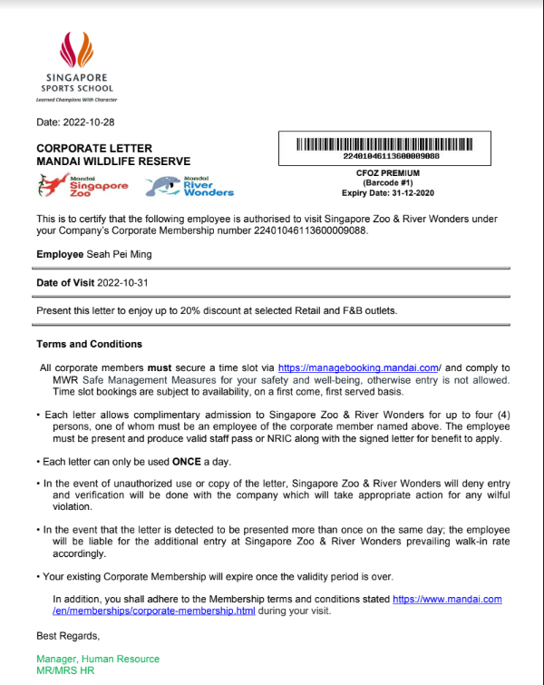
Electronic pass

Slide 19
Thanks!
Please keep this slide for attribution

